Slide 1
Project title-Spectrum Efficient MAC protocol for 5G Student name: Siddhi Kadam(21) Sanskruti Khandekar (26) Abhishek Jadhav(18) Krishnanath Kulkarni(28) Guide name- Prof. Savita Patil Group A13

Slide 2
Introduction
The increasing number of mobile users has resulted into high data traffic which needs more spectrum. Current 4G mobile network has some limitations due to its limited spectrum capacity. Hence there is a need to use spectrum efficiently for 5G.
The limited availability of the communication spectrum is one of the challenges which hinder the massive deployment of the 5G and beyond-5G based IoT systems.
The huge demand for the spectrum raises the difficulties in allocating the available frequency band. At the same time, due to various reasons, a large range of frequency band remain under-utilized.

Slide 3
Planning & Designing
Study of research papers and books.
Study of different MAC protocols.
Generating 5G waveforms using online simulations.
Creating a hybrid model using the techniques available.

Slide 4
Working
The high traffic volume problem can be solved by deploying small cells massively and integrating them with the existing deployed macro cells. Implementing such heterogeneous network with hybrid NOMA can enhance the performance.
By using superposition coding techniques at transmitter and successive interference cancellation at receiver(SIC).
According to OFDMA , the frequencies are grouped in channels which are then allocated with time sots .Same frequency channel can be used by all users but transmitted at different power levels. Hence, resources are efficiently used.
Through performance analysis and simulation, using Mac protocols we show that it reduces energy consumption while system is reliable and efficient.

Slide 5
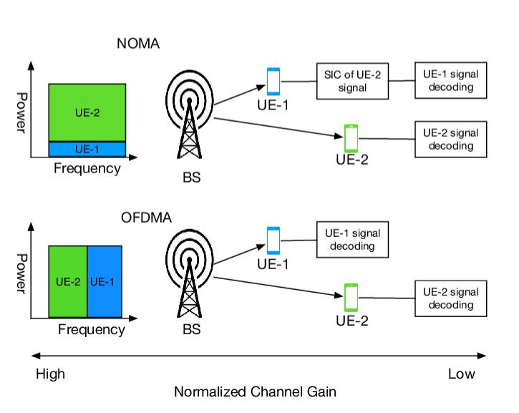

Slide 6
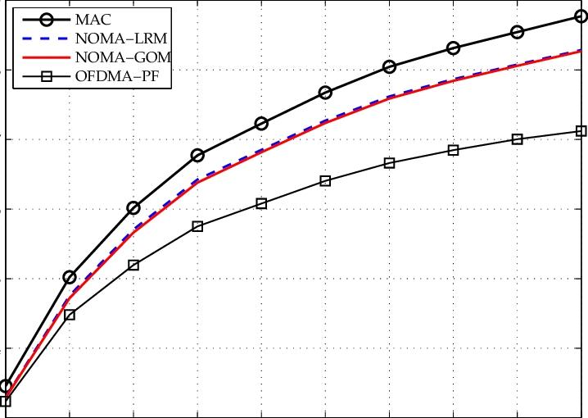
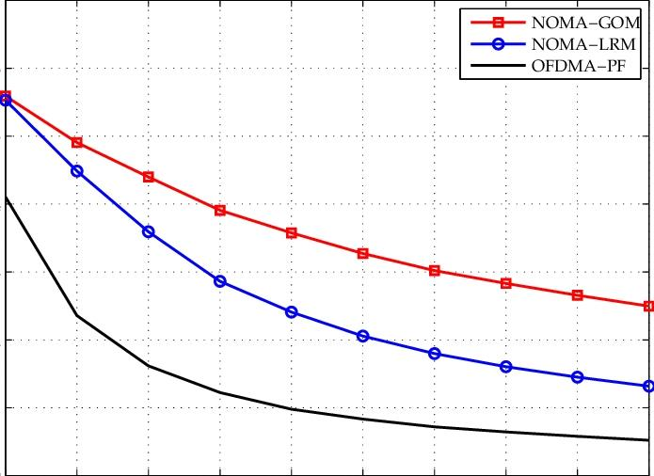

Slide 7
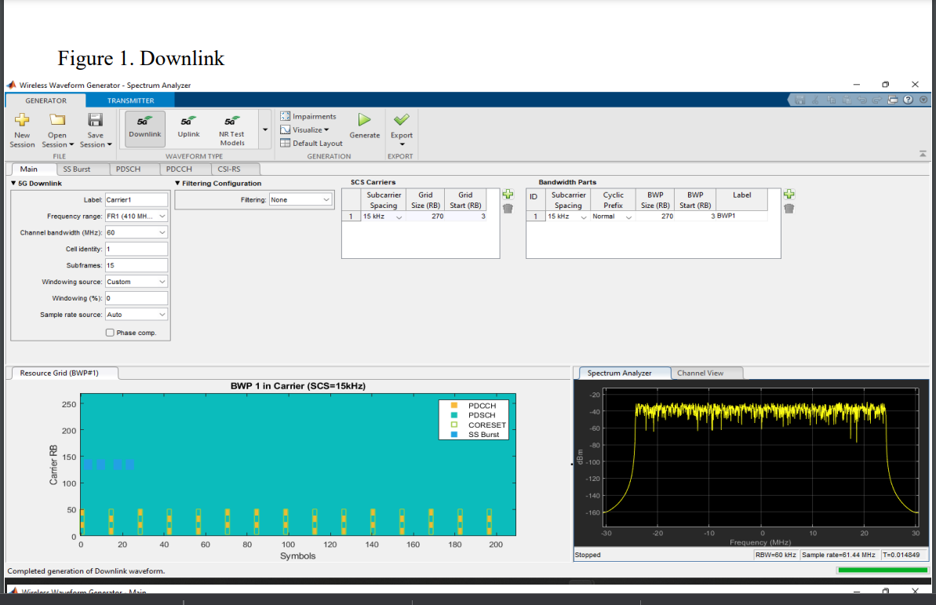
5G Waveform Generation

Slide 8
Conclusion
By simulating the 5G waveform generation using the required libraries in MATLAB and Python we compare the proposed technique with the NOMA and OFDMA techniques,we can show that the proposed techniqye is more efficient and reliable.

